Slide 1
Oedogonium:
Reproduction
Dr. Jahid Ali Malik

Slide 2
The reproduction in Oedogonium occurs by
i. Vegetative,
ii. Asexual and
iii. Sexual methods

Slide 3
Vegetative Reproduction:
By fragmentation: The filament may get broken into small fragments. Each fragment grows into new filament.
ASEXUAL REPRODUCTION:
By Zoospores
During normal favourable conditions the alga reproduce by the formation of zoospores.
Each mature zoospore is spherical or pear-shaped.
It is multiflagellated and possesses a crown of short flagella in ring at its Colourless anterior end.

Slide 4
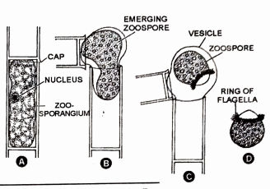
Development and liberation of zoospore

Slide 5
SEXUAL REPRODUCTION
Sexual reproduction is of oogamous types.
The female sex organ is oogonium
The male sex organ is antheridium
On the basis of distribution of sex organs, Oedogonium are grouped under the following categories
(1) Macrandrous species
(2) Nannandrous species

Slide 6
Macrandrous species:
In this case the male and female filaments are
morphologically similar.
The antheridia are borne on the normal filament.
may be of the following types-
Monoecious species:
The antheridia and oogonia
develop on the same
filament.
(b) Dioecious species:
In this case the antheridia and oogonia are borne on different filaments

Slide 7
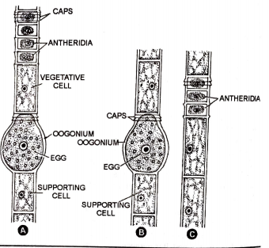
A. Macrandrous monoecious species showing antheridia and oogonia in the same filament.
B-C. Macrandrous dioecious specics showing oogonia and antheridia in different filaments

Slide 8
Nannandrous species:
Nannandrous species are dioecious and exhibit dimorphism.
The antheridia are borne on a special small few celled
filament, called nannandrium or 'dwarf male‘.
There are two kinds of nannandrous species-
Gynandrosporous: Both oogonia and androsporangia are borne on the same filament.
Idioandrosporous: The oogonia and androsporangia are borne on separate filaments.

Slide 9

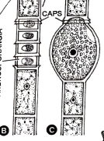
A. Nannandrous gynandrosporous sp
B-C. Nannandrous idioandrosporous sp

Slide 10
Thank You

